Slide 1
Household Electricity Usage Analysis using Spark MLlib for K-Means Clustering
Presenters:
Abhishek Manoj Sharma
Kunal Deshmukh
Ling Ouyang

Slide 2
About project
Using a dataset containing electric power consumption for a household, identify the electricity usage trends.
Visualize these trends into graphs.
Create clusters (groupings) based on hourly / monthly usage to identify to small groups of similar usage.
Visualize changes in cost for different values of “K” in K Means clustering.

Slide 3
Tools / technology used
Java
Apache Spark (for reading the data files)
Spark MLlib (for K-Means clustering)
JFreeChart (for visualization and creating graphs)

Slide 4
Dataset
Name: Individual household electric power consumption data set
Number of records: More than 2 million
Number of attributes: 9
Missing values: Yes

Slide 5
Dataset attributes
date: date in format dd/mm/yyyy
time: time in format hh:mm:ss
global_active_power: household global minute-averaged active power (in kilowatt)
global_reactive_power: household global minute-averaged reactive power (in kilowatt)
voltage: minute-averaged voltage (in volt)
global_intensity: household global minute-averaged current intensity (in ampere)

Slide 6
Dataset attributes
7. sub_metering_1: energy consumed by kitchen, containing mainly a dishwasher, an oven and a microwave.
8. sub_metering_2: energy consumed by the laundry room, containing a washing-machine, a tumble-drier, a refrigerator, and a light.
9. sub_metering_3: energy consumed by an electric water-heater and an air-conditioner.

Slide 7
SparkSession
It is the entry point to Spark SQL and is the very first object created while developing Spark SQL applications.
Creating Spark Session:
SparkSession sparkSession = SparkSession
.builder()
.master("local")
.config("spark.sql.warehouse.dir", dir_hadoop+"/warehouse")
.appName(“ElectricityConsumption")
.getOrCreate();

Slide 8
Data pre-processing
Converting the first two attributes to date and time and splitting them based on week number.
Converting remaining seven attributes of the data to valid float values.
Handling missing values (indicated by ‘?’).

Slide 9
Data pre-processing
Filtering and storing data in JavaRDD:
JavaRDD<HousePowerUtility> housePURDD = sparkSession
.read().textFile(csv_file)
.javaRDD().filter( str-> !(null==str))
.filter(str-> !(str.length()==0))
.filter(str-> !str.contains("Date"))
.filter(str->!str.contains("?"))
.filter(str->!(str.split(";").length<9))
.map(str -> HousePowerUtility.parseRecord(str));

Slide 10
K Means Clustering
It is an unsupervised clustering algorithm.
K Means aims to partition records into ‘k’ clusters.
Each record belongs to the cluster with the nearest mean which acts as a prototype for that cluster (also known as centroid).
It is an iterative algorithm.

Slide 11
K Means using Spark MLlib
Used Spark’s MLlib package for K-means clustering.
Calculated the cost (sum of squared errors) for each cluster.
Clustered data for different values of ‘K’ to find the most optimal ‘K’ (least cost)
Used the KMeans.train() and KMeansModel.predict() methods to generate and identify clusters.

Slide 12
K Means using Spark MLlib
KMeansModel clusters = KMeans.train(<RDD_Object>, <number_of_clusters_i.e._k>, <number_of_iterations>);
JavaRDD<Integer> predictions = clusters.predict(<RDD_Object>);
clusters.clusterCenters() returns the centers (centroids) for each of the k clusters
clusters.computeCost(<RDD_Object>) returns the cost of clustering

Slide 13
Data Visualization
JFreeChart:
An open-source framework for Java to create a wide variety of charts
Few charts that JFreeChart supports are:
X-Y charts (line, splatter, etc.)
Bar charts
Gantt charts
Pie charts

Slide 14
Data Visualization
Creating a JFreeChart graph:
Create a dataset DefaultCategoryDataset dataset = new DefaultCategoryDataset( );
Create a JFreeChart object (below is an example for line chart) JFreeChart linechart = ChartFactory.createLineChart(“Title", “X-Axis", “Y-Axis", dataset);
Save chart as PNG file ChartUtils.writeChartAsPNG(FileOutputStream, linechart,width, height);

Slide 15
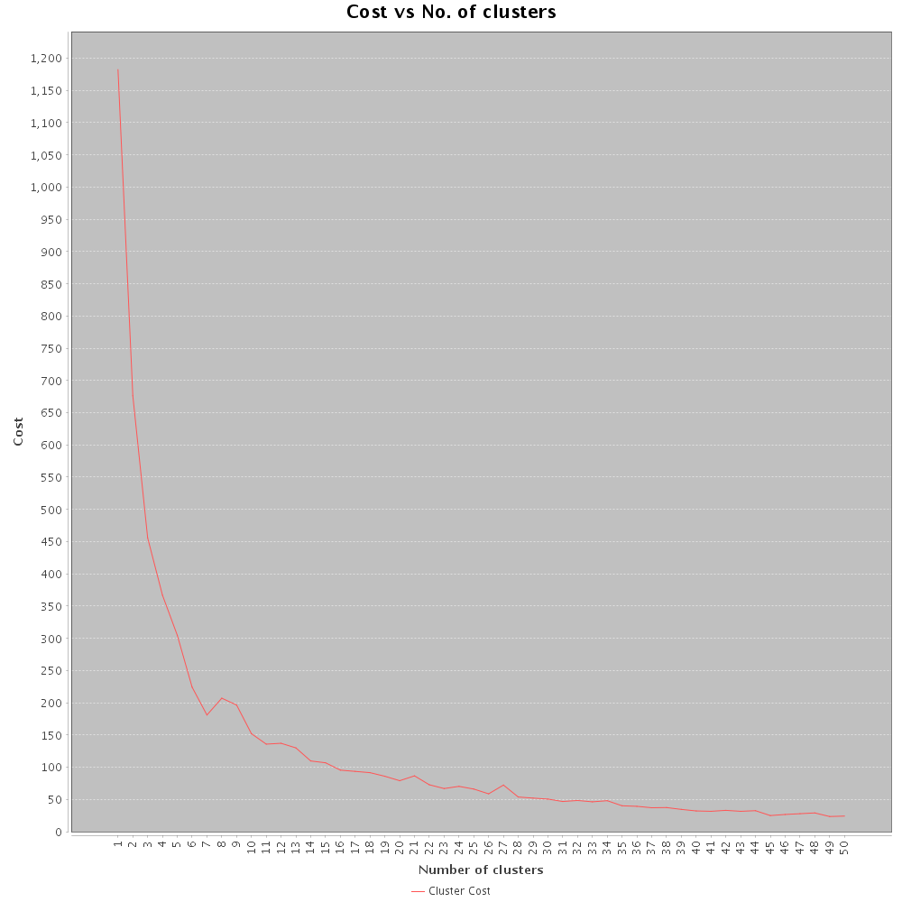
Data Visualization using our dataset
Cost analysis (K-Means):

Slide 16
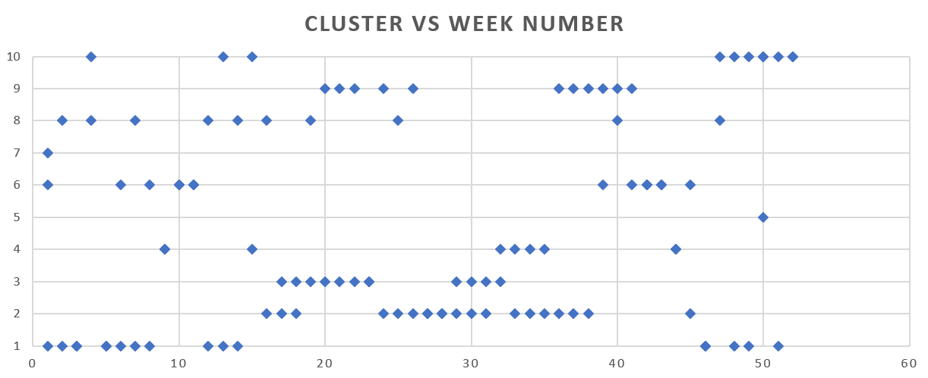
Data Visualization using our dataset
Clustering results:
Cluster number
Week number

Slide 17
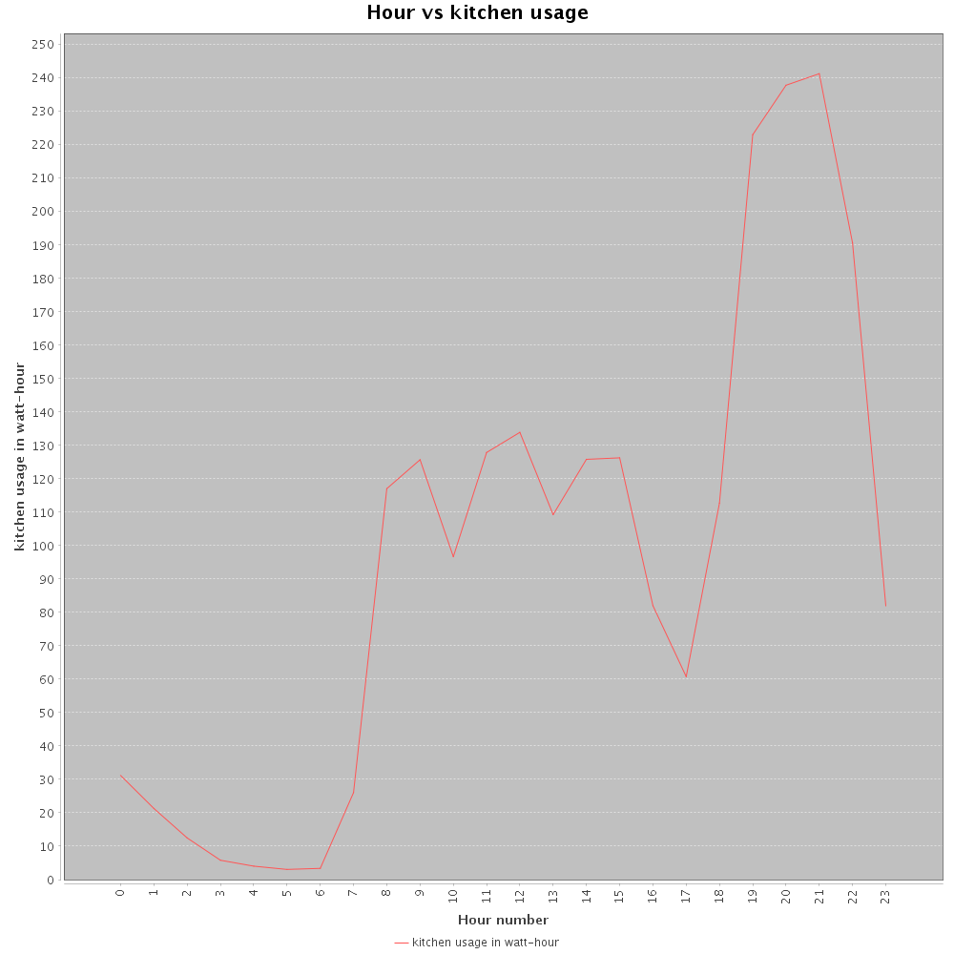
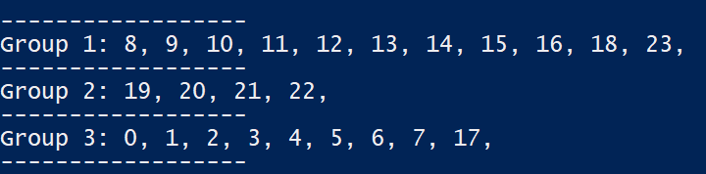
Data Visualization using our dataset
Usage of electricity from Kitchen based on hour of day:

Slide 18
Demo

